Slide 1
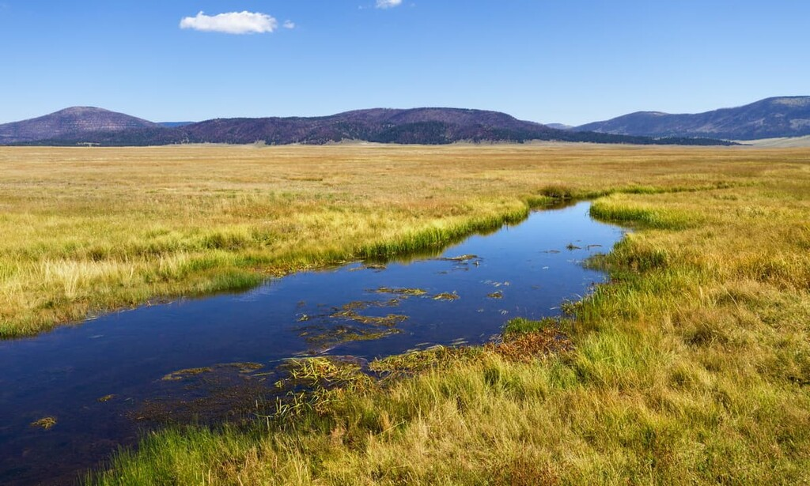
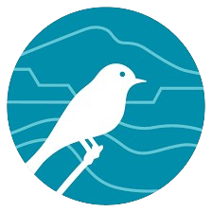
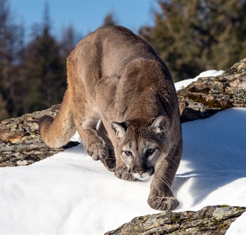
PEEC Nature Youth Group
PumaGuard
NeurIPS, Award Winning Project of 2024, High School Category.
And we are: Suchir Jha and Adis Bock
Members of PEEC Nature Youth Group: Zoe Bent, Nicolas Bock, Adis Bock, Ian McLean, Suchir Jha, Sebastian Koglin, Celia Pesiri, Tate Plohr, Phoebe Reid, Aditya Viswanathan, Hari Viswanathan

Slide 2
